Slide 1

Identification and preliminary analysis of hub genes associated with bladder cancer progression by comprehensive bioinformatics analysis¹ Han Wang, Junjie Liu, Yanyan Lou, Yang Liu, Jieqing Chen, Xinhui Liao, Xiuming Zhang, Chengzhi Zhou, Hongbing Mei & Aifa Tang, Scientific Reports, 2024
Presentation by Adam Cankaya acankaya2017@fau.edu Florida Atlantic University Department of Electrical Engineering and Computer Science COT 6900 Independent Study, Summer 2024

Slide 2

Brief Summary
Goal – identify differentially expressed genes (DEGs) between cancer and normal bladder tissue, focus on association with prognosis
Input – mRNA expression profiles from TCGA and GEO databases
Methods – weighted gene co-expression networks and pathway enrichment analysis
Results – ~3700 DEGs identified. CDH19, RELN, PLP1, and TRIB3 potential biomarkers for bladder cancer prognosis

Slide 3
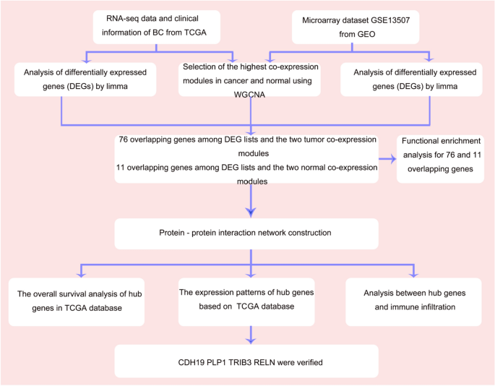
Workflow

Slide 4
Workflow
1. RNA profiles of BC and normal bladder tissue

Slide 5
Workflow
1) RNA profiles of cancerous and normal bladder tissue
2) R packages identify DEGs between normal and tumor

Slide 6
Workflow
1) RNA profiles of cancerous and normal bladder tissue
2) R packages identify DEGs between normal and tumor
3) R packages identify DEGs with biological relevance

Slide 7
Workflow
1) RNA profiles of cancerous and normal bladder tissue
2) R packages identify DEGs between normal and tumor
3) R packages identify DEGs with biological relevance
4) Online tools to visualize hub genes and construct protein-protein interaction network

Slide 8
Workflow
1) RNA profiles of cancerous and normal bladder tissue
2) R packages identify DEGs between normal and tumor
3) R packages identify DEGs with biological relevance
4) Online tools to visualize hub genes and construct protein-protein interaction network
5) Online tools to verify prognostic value, protein expression levels, and immune infiltration levels of hub genes

Slide 9
Workflow
1) RNA profiles of cancerous and normal bladder tissue
2) R packages identify DEGs between normal and tumor
3) R packages identify DEGs with biological relevance
4) Online tools to visualize hub genes and construct protein-protein interaction network
5) Online tools to verify prognostic value, protein expression levels, and immune infiltration levels of hub genes
6) Identify prognosis significant DEGs, P < 0.05

Slide 10
Step 1 – RNA profile data
The Cancer Genome Atlas – TCGA
Data from 414 BC samples, 19 normal tissue samples
Data covers 14,830 genes (genes with count per million > 1)
Gene Expression Omnibus – GEO
Data from 165 BC samples, 9 normal tissue samples
Data covers 24,324 genes

Slide 11
Step 2 – Identify DEGs
R packages edgeR and limma identify differentially expressed genes between cancer and normal tissue
|log FC| > 1.0 , log fold change value indicates overexpression
adjusted P < 0.05, indicates a <5% false discovery rate
R package WGCNA builds weighted co-expression networks
Captures both positive and negative correlations between genes
Creates hierarchical tree with branches representing gene modules
Scale-free network
Optimal powers of 3 and 9
Two modules with highest positive correlation in normal and tumor groups selected for further analysis
Notes:
False discovery rate FDR = FP / (FP + TP) = ratio of false positive classifications to total number of positive classifications
Total number of positive classifications includes both false positives and true positives
FDR adapts so that the same number of false positives will have different implications depending on the total number of discoveries
The number of false positives becomes more acceptable if we are also getting a lot more true positives
Gene modules - group of functionally related co-expressed genes, jointly contributes to a cellular phenotype or functional state

Slide 12
Step 2 – Identify DEGs
R packages edgeR and limma identify differentially expressed genes between cancer and normal tissue
|log FC| > 1.0 , log fold change value indicates overexpression
adjusted P < 0.05, indicates a <5% false discovery rate
R package WGCNA builds weighted co-expression networks
Captures both positive and negative correlations between genes
Creates hierarchical tree with branches representing gene modules
Scale-free network
Optimal powers of 3 and 9
Two modules from each data set with highest positive correlation in normal and tumor groups selected for further analysis
Notes:
False discovery rate FDR = FP / (FP + TP) = ratio of false positive classifications to total number of positive classifications
Total number of positive classifications includes both false positives and true positives
FDR adapts so that the same number of false positives will have different implications depending on the total number of discoveries
The number of false positives becomes more acceptable if we are also getting a lot more true positives
Gene modules - group of functionally related co-expressed genes, jointly contributes to a cellular phenotype or functional state

Slide 13
Step 3 – Identify DEGs with biological relevance
Normal tissue
TCGA module with r = 0.85, p < 1e-200
GEO module with r = 0.64, p = 9.6e-11
Tumor tissue
TCGA module with r = 0.7, p = 1.7e-95
GEO module with r = 0.49, p = 3.6e-65
11 genes in both normal modules, 76 genes in both tumor modules
Total of 87 overlapping genes used for further analysis
Notes:
r is the Pearson correlation coefficient which measures the linear correlation between two sets of data
Heatmaps and volcano plots used to visualize modules
Venn diagrams used to visualize overlapping genes between modules

Slide 14
Step 3 – Identify DEGs with biological relevance
Gene Ontology (GO) - identifies overrepresented terms in three categories
Biological Process (BP)
Normal – neurotransmitter update, long-term synaptic potentiation, and serotonin transportation
Tumor - nuclear division, sister chromatid segregation, and regulation of chromosome segregation
Molecular Functions (MF)
Normal - SNARE binding and iron ion binding
Tumor - ATPase activity and 3′ to 5′ DNA helicase activity
Cellular Components (CC)
Normal – growth cone and site of polarized growth
Tumor – chromosomal regions, condensed chromosomes, centromeric regions, and condensed chromosome kinetochores
Notes:
Functional annotation of 87 overlapping DEGs
GO signifys biological relevance of genes
SNARE binding - soluble N-ethylmaleimide sensitive factor attachment protein receptor

Slide 15
Step 3 – Identify DEGs with biological relevance
Kyoto Encyclopedia of Genes and Genomes (KEGG)
pathway enrichment analyses…connects genomes and biological processes
Normal genes - arachidonic acid metabolism and synaptic vesicle cycle
Tumor genes - mitotic nuclear division, regulation of mitotic nuclear division, and metaphase/anaphase transition of the mitotic cell cycle
Notes:
KEGG integrates genomic, chemical, and systematic functional information to connect genomes and biological processes

Slide 16
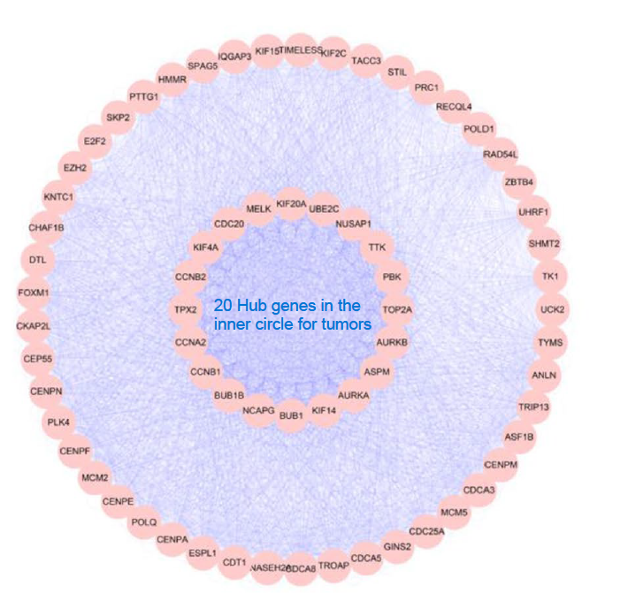
Step 4 – Visualize hub gene interaction networks
Protein-Protein Interactions (PPI) network constructed using STRING for the tumor group of 78 genes shows a subgroup of 20 hub genes…
Notes:
STRING is Search Tool for the Retrieval of Interacting Genes/Proteins
PPI are physical contacts between protein molecules as a result of biochemical events

Slide 17
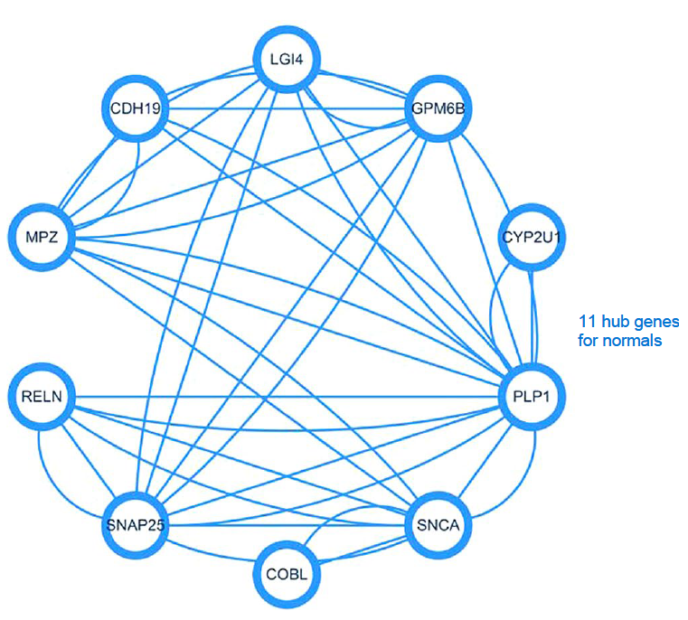
Step 4 – Visualize hub gene interaction networks
…while the normal group shows all 11 genes interacting without any subgroup of hub genes
Notes:
STRING is Search Tool for the Retrieval of Interacting Genes/Proteins
PPI are physical contacts between protein molecules as a result of biochemical events

Slide 18
Step 5 - Prognostic value of hub genes
After PPI visualization...
20 hub genes from tumor tissue, 11 genes from normal tissue
Use of R survival package finds…
9 genes associated with BC prognosis
4 genes significantly associated – CDH19, RELN, PLP1, and TRIB3
All genes also associated with clinical stage of BC
CDH19, RELN, and PLP1 levels higher in normal tissue than tumor tissue
TRIB3 higher in tumor tissue than normal tissue (some contrary evidence found in Human Protein Atlas)

Slide 19
Step 6 – Identify prognostic significant DEGs

Slide 20

Results

Slide 21
Questions

Slide 22
Conclusions

Slide 23
Next steps
Gather data sets
Implement R scripts
Utilize online tools
Attempt to validate/replicate results and maybe expand

Slide 24
References
Wang, H., Liu, J., Lou, Y. et al. Identification and preliminary analysis of hub genes associated with bladder cancer progression by comprehensive bioinformatics analysis. Sci Rep 14, 2782 (2024). https://doi.org/10.1038/s41598-024-53265-z

